Slide 1
Laufersweiler’s Synagogue
Notes:
Title

Slide 2
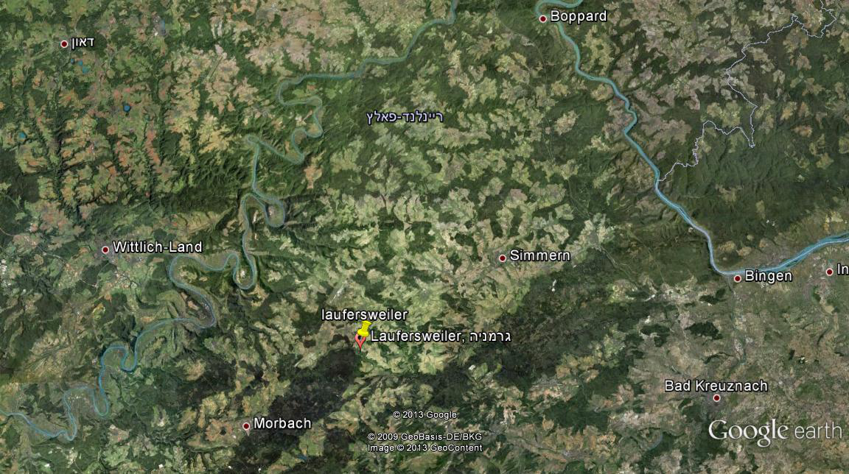
Mosel
Rhein
Notes:
map

Slide 3
Between 1825 to 1840 the first synagogue was built in Laufersweiler.
In 1839 a great fire in the village completely burned down the synagogue.
Notes:
Our first knowledge of Jewish community in the village comes from document dated for 1748.At that time there wasn't a synagogue and the Thora lessons conducted at the teacher house.
1825- a jewish teacher came to the village and didn't have a synagogue,so he teach the jewish community in his own house.
1839- between 1825-1839 a synagogue was built, we know about it from a report from the near town mayor which say that the synagogue was completely burned down-referring to the great fire accrued in 1839.

Slide 4
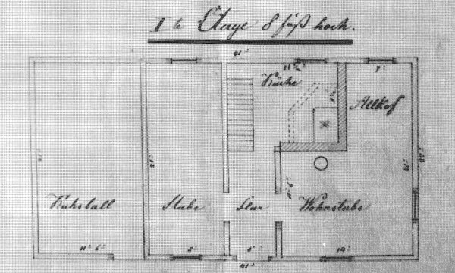
In 1844 a new synagogue was built
it included cowshed, room for studying for boys and girls, a flat for the teacher and a Mikwe in the cellar.
_{First floor:}
kitchen
Living room
Cowshed
entrance hall
living room
Notes:
1844- After the great fire at 1839 many buildings were in bad shape. Due to financial problems a new synagogue was built in 1844, after collecting money . On August 1844, for two days the opening of the synagogue occurred.
The synagogue was a typical countryside synagogue with cowshed flat for the teacher.probably Mikwe in the cellar.

Slide 5
Second Floor:
Two small rooms
Barn
Girl’s Room
Boy’s Room
Notes:
second floor- barn, rooms for boys and girls

Slide 6
The synagogue had enough place for 150 seats, but due to the growing community over the years and lack of maintenance it was closed in 1908. Conservation and expansion were not an option because of the high costs.
Notes:
17 families cared for the synagogue, each family could reserve two seats. all together it had place for about 150 people.
architecture- the fundament was made out of the typical slade stone, above that was timbered structure and the spaces between the logs were filled with clay. the roof was covered with slade.
in 1908 the building was in critical condition, the walls were so thin that you could see through them. the condition became worse and the authorities closed the synagogue. The costs for resturation was too high so the community decided in 1909 to build a new synagogue.

Slide 7
In 1910 a new synagogue was built. Architect: Nikolaus Elz Hirschfeld. Style: Moorish-Arches and half rounded windows.
Notes:
new synagogue- At 1910 the architect Nikolaus Elz from the nearby village, designed a new two-story synagogue. In a Moorish style-that including arches and half rounded windows.

Slide 8
Notes:
.new building opening- the opening festivities lasted two days during June 1911 .

Slide 10
1911:

Slide 11
Postcard of the village:

Slide 12
Destruction of the building:
In November 1938, during the ‘Crystal Night’ the interior was completely vandalized by SA members and local Nazis.
The ‘Star of David’ was hammered down.
The building wasn’t burned.
Notes:
1938- on November 1938, during the Crystal night the synagogue was brutally vandalized. The 'Star of David' was hammered down from the gable. books and Menorahs were destroyed. The interior was completely harmed . The synagogue wasn't completely burned, because the neighbors prevented the Nazis from doing that, they were afraid for their own houses that were very close, and also because that when the village collected money after the great fire of 1839 , thanks to the Jews population, the Rothschild family donate money for the Rehabilitation of the church and synagogue . They couldn't let the synagogue burn down.

Slide 13
June 1955:
The building was sold to the civil community .
The original architecture was completely changed.
Notes:
1955- for many years the synagogue remained unused. on June 1955 the Jewish community of the area sold the building to the civil community of Laufersweiler and then the original architecture was completely changed.

Slide 14
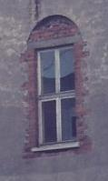
Notes:
The arch over the door with the inscription was put away, .the windows were changed from half-round to rectangular structures.

Slide 15
Notes:
. the two windows at the 'aron kodesh' side, in the east, were walled up. Also the women gallery disappeared.
the building used as public washing facility and refrigeration.

Slide 16
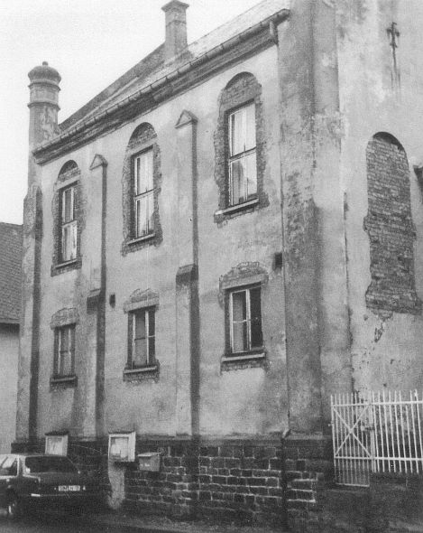
Beginning of the 1980s –what would happen to the building?
Notes:
80's- for decades the synagogue wasn't a topic of discussion in the village. the walls and the whole building were in bad condition. Public laundries and fridges were no longer needed. The community wanted to tear down the building. this act means also to push away the past and to erase it. The mayor of that time fought for preservation of the building, because it was the only synagogue in the district which still can be detected as a synagogue.

Slide 17
1985-the building was listed as ‘Historic Monument’
marking as a cultural monument
Notes:
1985 it was listed as historical monument.

Slide 18
1986-conservation began:
The inscription:
Notes:
1986- restoration began . fortunately descendants of the original builder were able to help in the process.
-The Hebrew inscription above the entrance was digged out from the cemetery, the mayor remembered were it was buried. The 3 parts were put together renovated by a stonemason. And put onto the original place over the door.

Slide 19
Notes:
In place!

Slide 20
The ‘Star of David’ was returned:
Notes:
Star of David was returned: set on the highest point of the building but not higher than the churches in Laufersweiler.

Slide 21
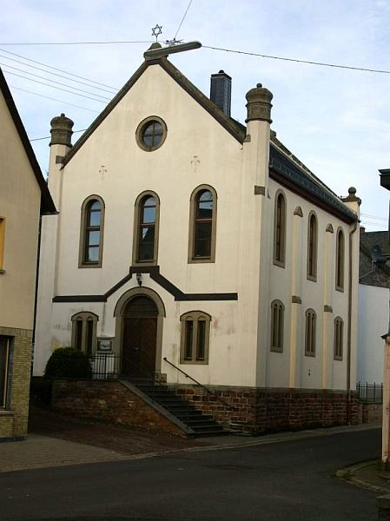
Notes:
The front: Before&after

Slide 22
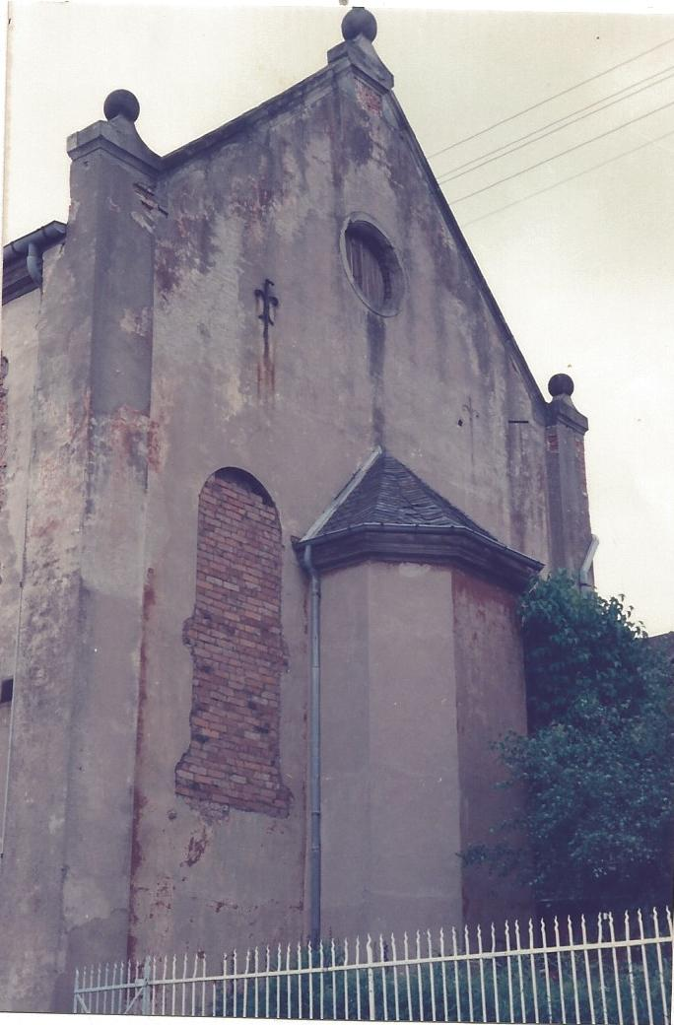
Notes:
The east wall-Before&after-The 'Aron Kodesh' wall- the windows stayed blocked.

Slide 23
Notes:
Front door

Slide 24
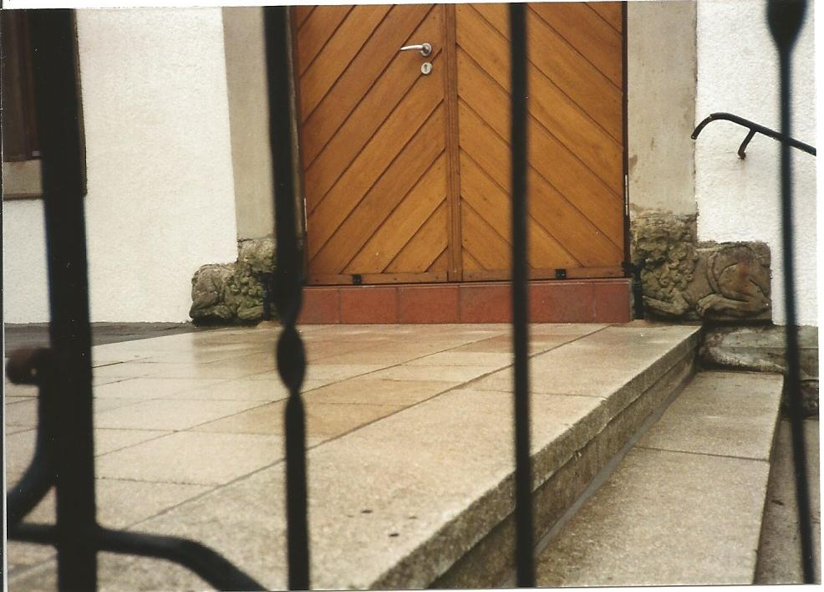
The ‘Lion of Judah’:
Notes:
The ‘Lion of Judah’- one of the most popular symbol of the jewish people. stayed in the same place since 1911, never been moved and never had any restoration process.

Slide 25
Sculpture in the ‘Aron Kodesh’ area Artist: Karl Heinz Brust, 1987.

Slide 26
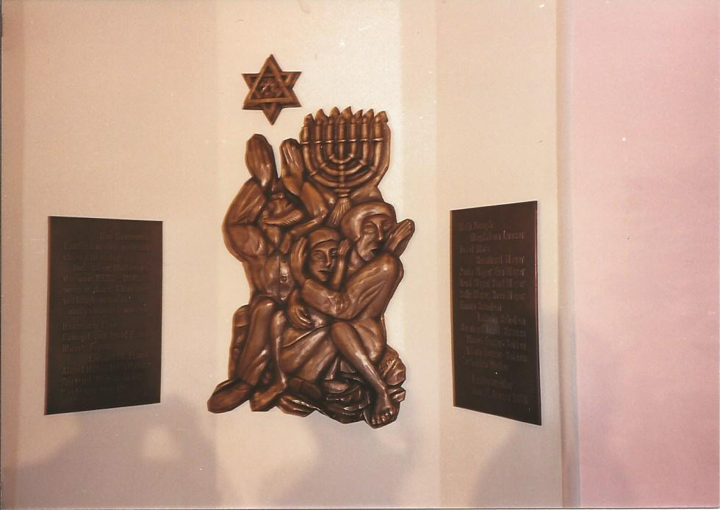
The ‘Aron-Kodesh’ area:
Notes:
Sculpture in the ‘Aron Kodesh’ area- an artist from the near by town created a bronze sculpture for the 'Aron kodesh' area, and from it's both sides there are panels with the names of 25 people of the Jewish community that die during the Holocaust.

Slide 27
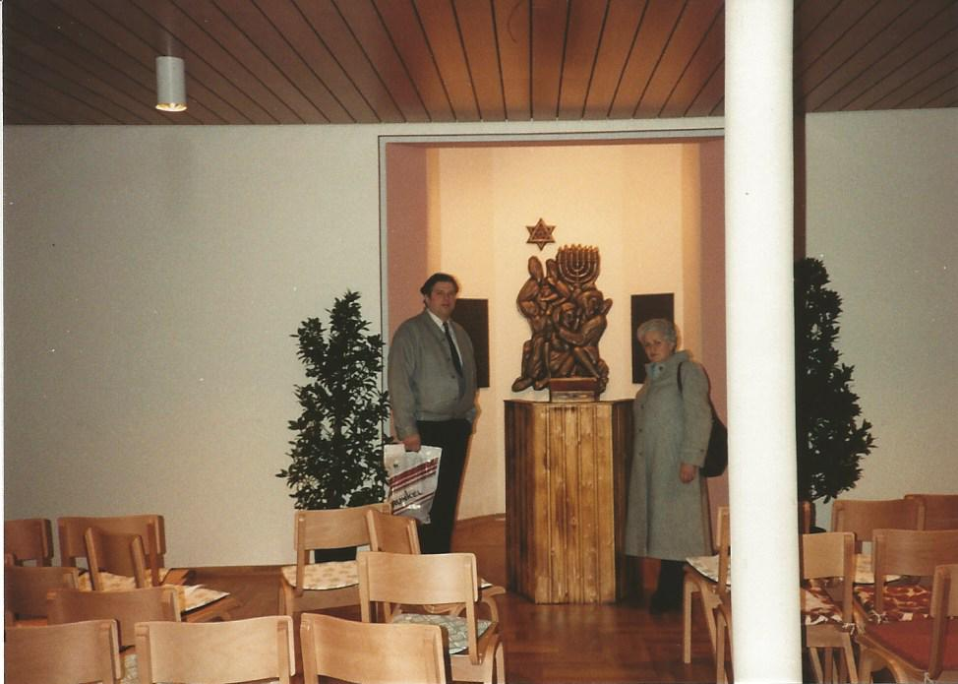
31.1.1988 the synagogue re-opened:
Shimon Mayer
Notes:
re-opening-1988-on January- the Jewish Descendants were invited to be a part of it.
on 1989 an Association was founded to keep the memory of the synagogue and Jewish history alive.

Slide 28
1998
Notes:
28.29. over the years the building got into bad condition again and an Maintenance acts were needed

Slide 29
2000

Slide 30
2001 Maintenance
Notes:
.2001-wood worm nest was found-and the wood parts needed to be changed. A new roof, stairway to the entrance, central heating was added to prevent Humidity. And also new plastering on the walls.

Slide 31
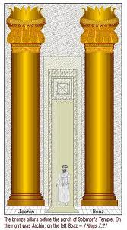
Representing Boaz and Jachin
Notes:
The small towers on the roof Representing Boaz and Jachin- the two pillars at the entrance of the Temple in Jerusalem, with the inscription "god is strength" and "god will erect".

Slide 32
Representing the ‘Tablets of Law’
Notes:
. half rounded arched windows Representing Tablets of Law.

Slide 33
Notes:
Inside the synagogue it dosen't look like traditional synagogue. The ground floor is used as a memorial room with permanent exhibition of Jewish life in Laufersweiler, represented by text, pictures and Jewish objects.
The synagogue is used as a place for learning the Jewish life and history. also to deal with the present, groups comes to get an educational programs and the synagogue is used as a live evidence for politically socially and historical behavior.
-Jewish week- each year, in October there is a "Jewish week" with concerts, lectures,films and more activities related to Jewish life.
-at 2011 was a great celebration of 100 years to the synagogue!

